Slide 1
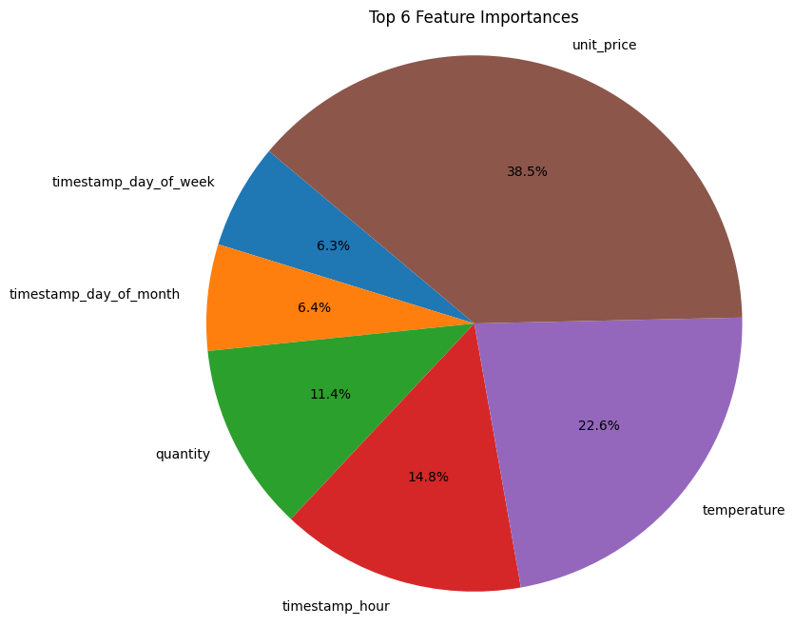
Relative importance of features for prediction of estimated stock percentage
Key Insights
Product Categories: While product categories contribute, they are not predominant predictors of stock levels.
Significant Predictors:
Unit Price: Higher unit prices lead to lower stock levels, highlighting price sensitivity.
Temperature: Temperature fluctuations impact stock levels, emphasizing storage conditions.
Hour of Day: Different hours influence stock levels, reflecting customer behavior.
We got an accuracy of around 50% with the present data and model. We would need more larger dataset in order to test this model for production.

